Slide 1
XY Dependence in 3D Quad Measurement

Slide 2
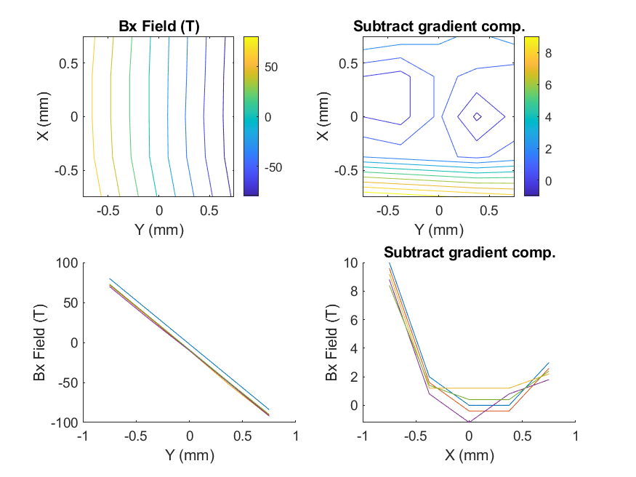
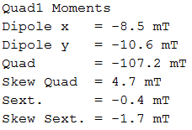
Quad1, Bx
text

Slide 3
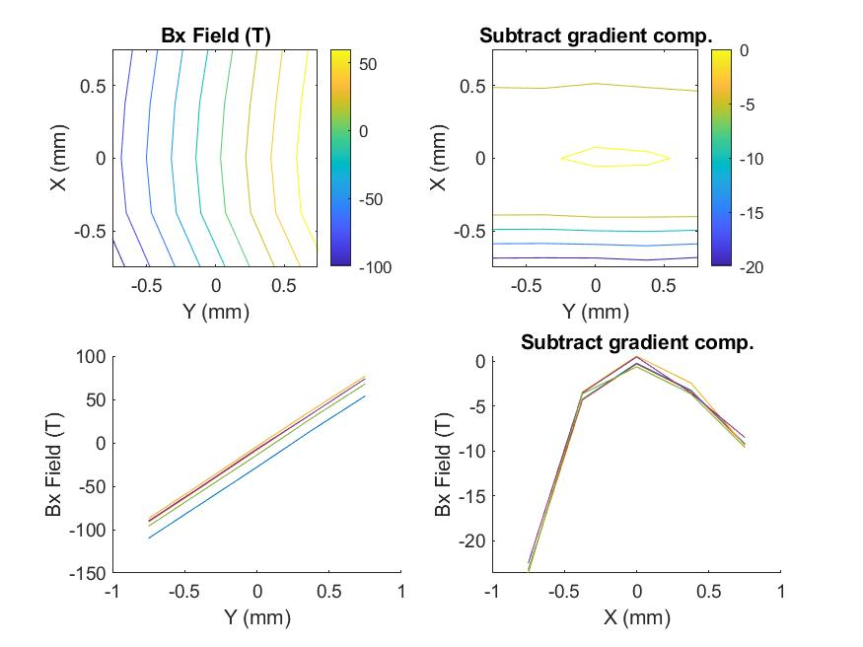
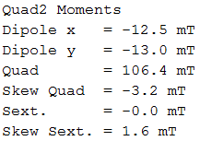
Quad2, Bx
Sign of sextupole moment flipped due to different quad focusing?

Slide 4
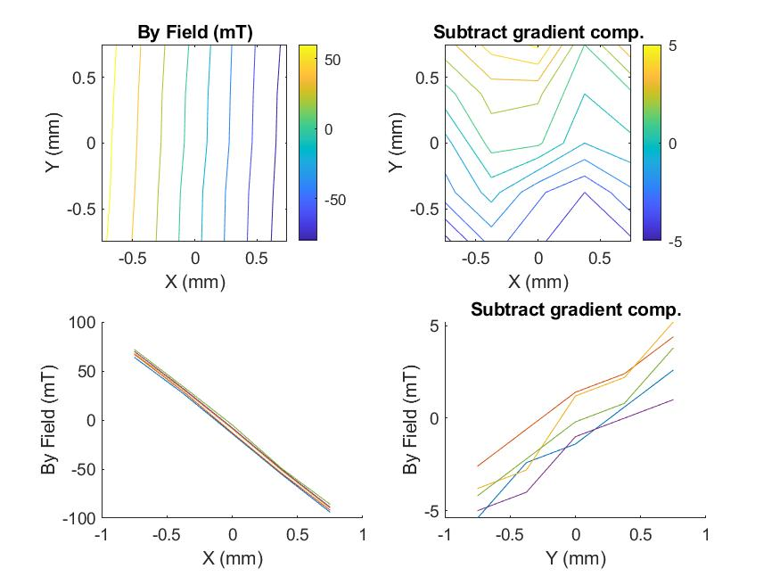
Quad1, By
By vs Y dependence from error in Probe roll angle?
This would imply same errors between Quad1 and Quad2

Slide 5
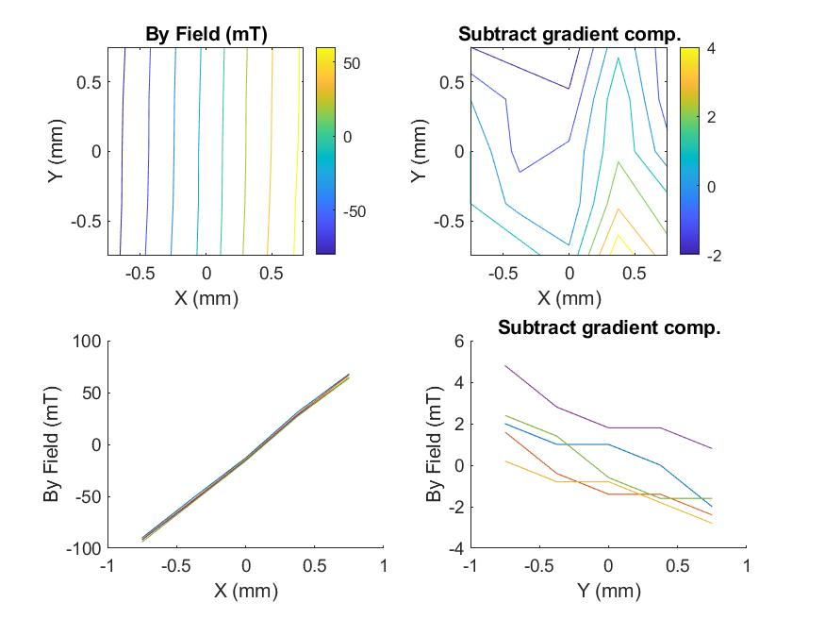
Quad2, By

Slide 6
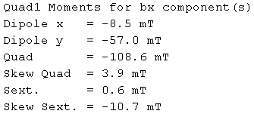
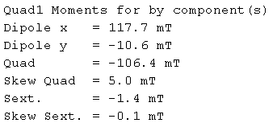
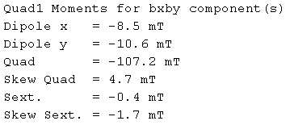
Moment Fits by Field component
Bx only:
By only:
Both:

Slide 7
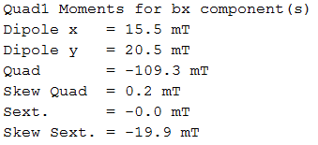
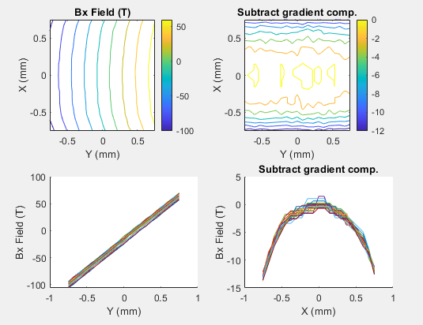
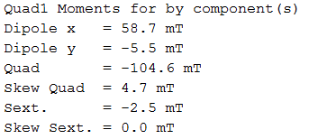
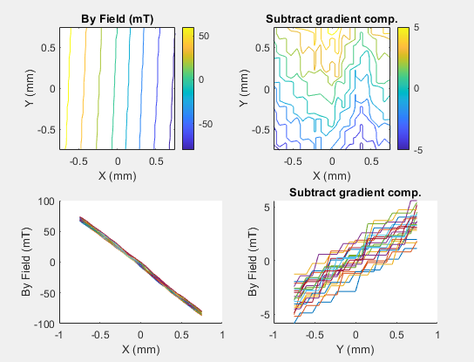
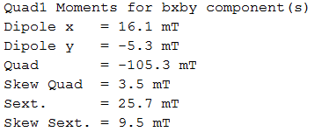
Finer Resolution xy-slice

Slide 8
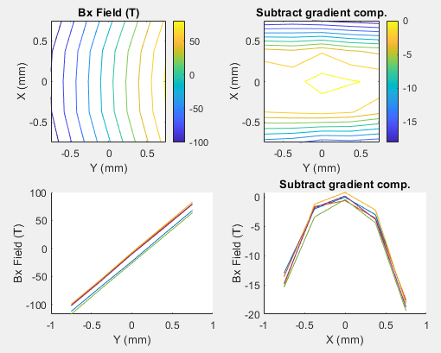
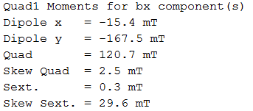
Shunt out, 3D scan (gradient=120)
Quad1, Bx
Remove shunt 5 turns
Measured 120 gradient with 1d scan

Slide 9
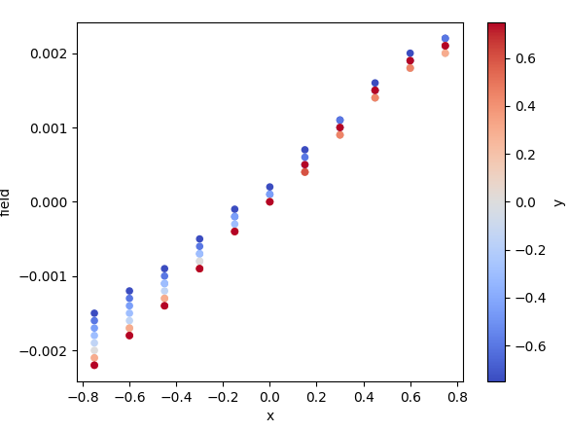
Bz 2d Scan
Verified there was minimal (<couple mT) Bz vs z dependence excluding entrance/exit of quad.
Bz vs. y was non-existent
Bz vs. x is minimal and probably due to slight misalignment.

